Slide 1
A Tale of Two Villains: Bandit, Procrustes, and Their Regrets
@ Simons Foundation, 162 Fifth Avenue, New York City
Liangzu Peng (lpeng25@jhu.edu)
Johns Hopkins University
TheoriNet Retreat, September 28, 2022

Slide 2
Contents
Review and Thoughts on:
Collaborative Linear Bandits with Adversarial Agents:
Near-Optimal Regret Bounds
NeurIPS 2022
Aritra Mitra, Arman Adibi, George J. Pappas, and Hamed Hassani

Slide 3

(Outlier-Robust) Linear Regression
Linear Regression
$y_{i}≈a_{i}^{T}θ^{∗}$ for all $i∈\{1,…,m\}$
$θ^{∗}∈ℝ^{n}$
Outlier-Robust Linear Regression
$y_{i}≈a_{i}^{T}θ^{∗}$ for some $i∈\{1,…,m\}$
Goal:
estimate $θ^{∗}$ from data $\left\{\left(y_{1},a_{1}^{}\right),…,\left(y_{m},a_{m}^{}\right)\right\}$

Slide 4
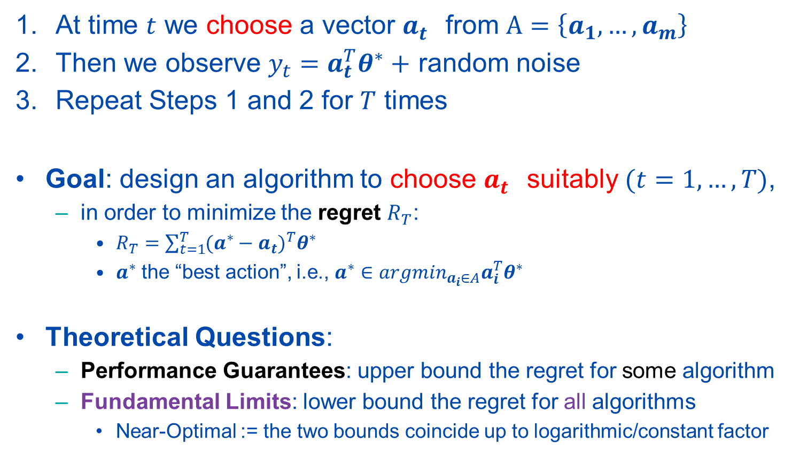
Linear Bandits: The Basic Setting
At time $t$ we choose a vector $a_{t}^{}$ from $A=\left\{a_{1},…,a_{m}\right\}$
Then we observe $y_{t}=a_{t}^{T}θ^{∗}+$ random noise
Repeat Steps 1 and 2 for $T$ times
Goal: design an algorithm to choose $a_{t}^{}$ suitably $(t=1,…,T)$,
in order to minimize the regret $R_{T}$:
$R_{T}=\sum_{t=1}^{T}{{(a^{∗}−a_{t})}^{T}θ^{∗}}$
$a^{∗}$ the “best action”, i.e., $a^{∗}∈{argmin}_{a_{i}∈A}a_{i}^{T}θ^{∗}$
Theoretical Questions:
Performance Guarantees: upper bound the regret for some algorithm
Fundamental Limits: lower bound the regret for all algorithms
Near-Optimal := the two bounds coincide up to logarithmic/constant factor

Slide 5
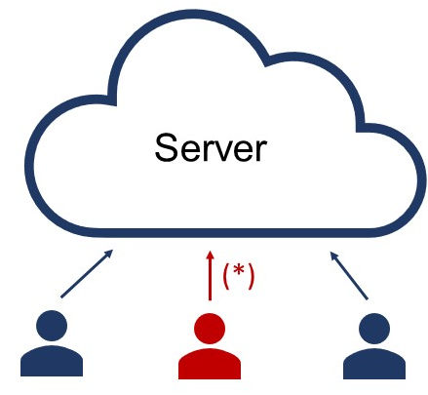
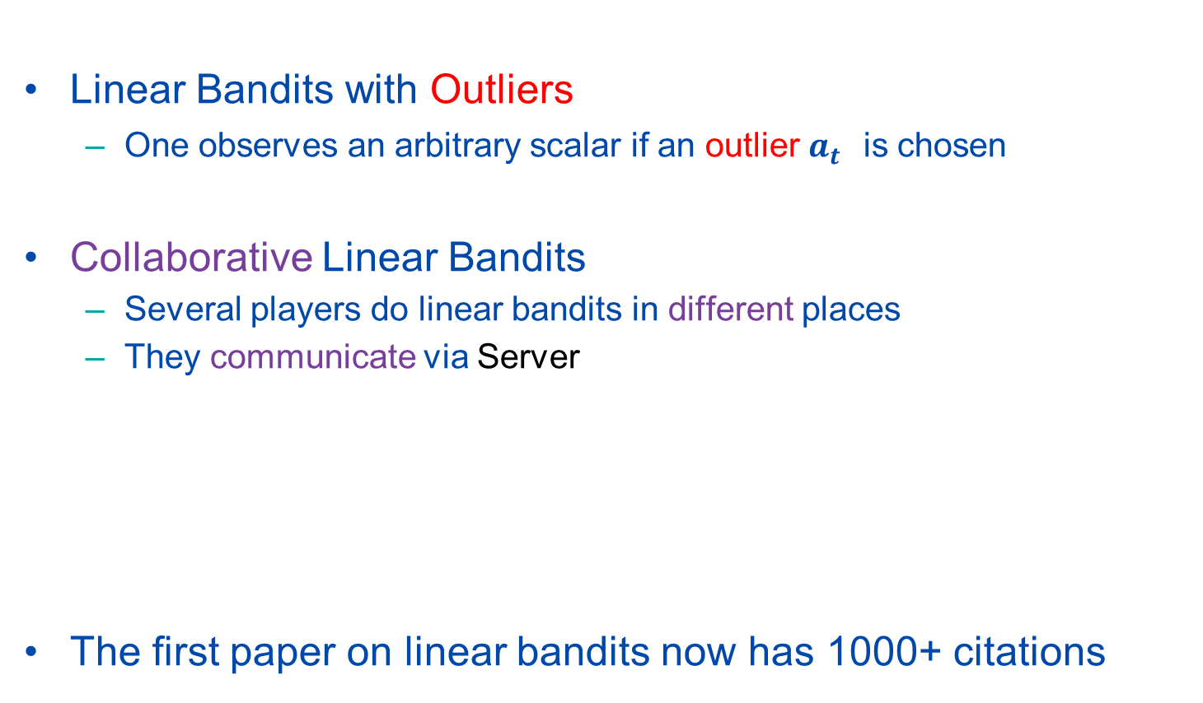
Linear Bandits: Two Extensions
Linear Bandits with Outliers
One observes an arbitrary scalar if an outlier $a_{t}^{}$ is chosen
Collaborative Linear Bandits
Several players do linear bandits in different places
They communicate via Server
The first paper on linear bandits now has 1000+ citations

Slide 6
Review on [1] 1/2
Linear Bandits
with Outliers
Main Question: Can we collaborate with enemies?
such that the regret is minimized
[1]: In short, yes, and in a near-optimal way
Collaborative
Linear Bandits
with Outliers
[1]
Linear Bandits
Collaborative
Linear Bandits
[1] A. Mitra, A. Adibi, G. J. Pappas, H. Hassani, “Collaborative Linear Bandits with
Adversarial Agents: Near-Optimal Regret Bounds”, NeurIPS 2022.

Slide 7

Review on [1] 2/2
Linear Bandits
with Outliers
[1]: In more detail, we have (w.h.p.)
$$Ω\left(α\sqrt{nT}\right)<regret<O\left(\left(a+\frac{1}{\sqrt{P}}\right)\sqrt{nT}\right)$$
$α$: outlier rate (assume $α<0.5$).
$P$: the number of players
Collaborative
Linear Bandits
with Outliers
[1]
Linear Bandits
Collaborative
Linear Bandits
[1] A. Mitra, A. Adibi, G. J. Pappas, H. Hassani, “Collaborative Linear Bandits with
Adversarial Agents: Near-Optimal Regret Bounds”, NeurIPS 2022.

Slide 8
Limitation of Linear Bandits
Bandit linear regression is the simplest setting
linear, unconstrained
Can we handle non-linearity or non-convexity in the bandit setting?

Slide 9
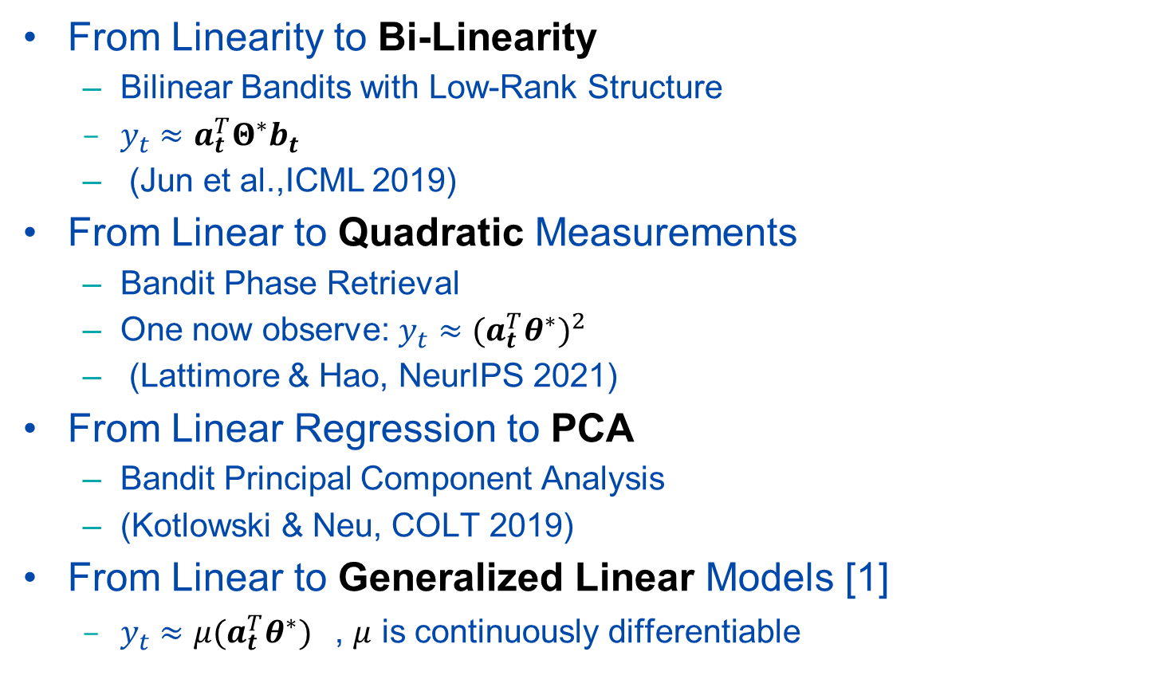
Extensions of Linear Bandits
From Linearity to Bi-Linearity
Bilinear Bandits with Low-Rank Structure
$y_{t}≈a_{t}^{T}Θ^{∗}b_{t}$
(Jun et al.,ICML 2019)
From Linear to Quadratic Measurements
Bandit Phase Retrieval
One now observe: $y_{t}≈{{(a}_{t}^{T}θ^{∗})}^{2}$
(Lattimore & Hao, NeurIPS 2021)
From Linear Regression to PCA
Bandit Principal Component Analysis
(Kotlowski & Neu, COLT 2019)
From Linear to Generalized Linear Models [1]
$y_{t}≈μ{{(a}_{t}^{T}θ^{∗})}^{}$, $μ$ is continuously differentiable
[1] A. Mitra, A. Adibi, G. J. Pappas, H. Hassani, “Collaborative Linear Bandits with
Adversarial Agents: Near-Optimal Regret Bounds”, NeurIPS 2022.

Slide 10
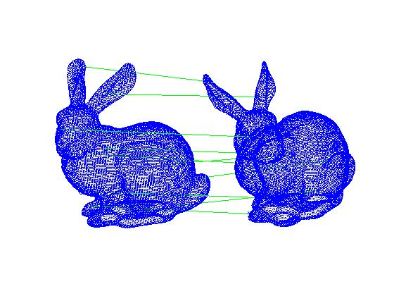
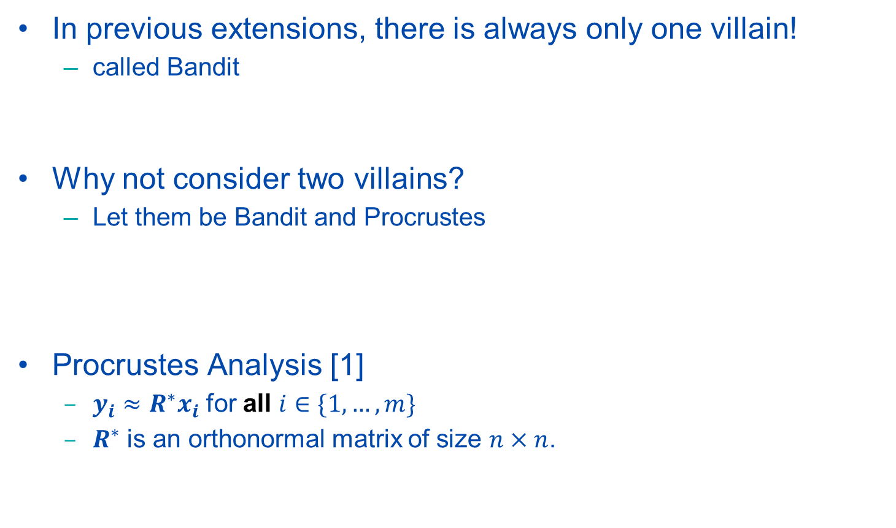
Proposed Extension
In previous extensions, there is always only one villain!
called Bandit
Why not consider two villains?
Let them be Bandit and Procrustes
Procrustes Analysis [1]
$y_{i}≈R^{∗}x_{i}$ for all $i∈\{1,…,m\}$
$R^{∗}$ is an orthonormal matrix of size $n×n$.
“The villain Procrustes forced his victims to sleep on an iron bed; if they did not fit the bed he cut off or stretched their limbs to make them fit” --- Richard Everson
[1] Gower and Dijksterhuis, Procrustes Problems, 2004.

Slide 11
Bandit Procrustes Analysis (BPA)？
Proposal: Formulate the problem of Bandit Procrustes Analysis (BPA), and find regret bounds for 4 different cases:
Challenge: Non-Convexity
need to analyze projection onto the set of orthonormal matrices
BPA
with Outliers
Collaborative
BPA
with Outliers
BPA
Collaborative
BPA

